Slide 1
Probability EQ: What words can you use to describe situations involving chance? New topic Important note that the assessment for this topic will occur in Term 3 week 6 after we have covered interest rates and loans. It is a combined test.

Slide 2
24
7
30
Probability
Date
EQ – What words can you use to describe situations involving chance?
Probability is the chance that something will happen.
In everyday conversations we use words that indicate the chance or probability that something will happen.

Slide 3
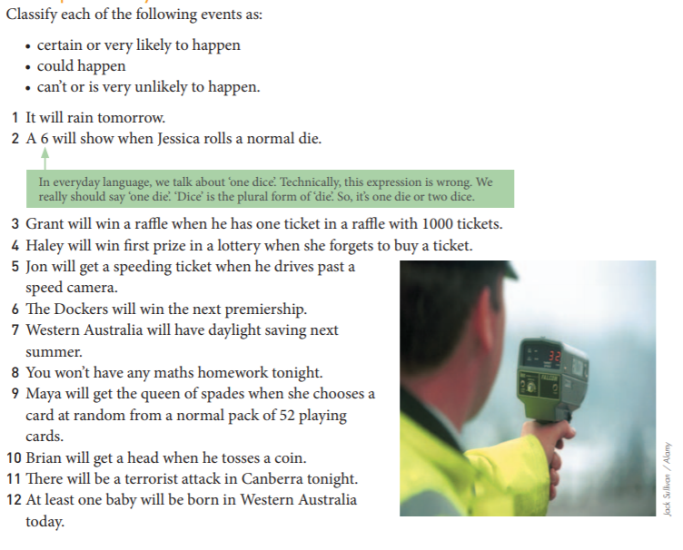
24
7
30
Probability
Date
EQ – What words can you use to describe situations involving chance?

Slide 4

24
7
30
Probability
Date
EQ – What words can you use to describe situations involving chance?
What is the probability scale
Probability is the chance of an event happening.
Probability Scale
Probability can be described in
Decimals
Fractions
Percentages
Words

Slide 5
24
7
30
Probability
Date
EQ – What words can you use to describe situations involving chance?
Sample Space
The sample space is a list of all possible outcomes
Example – What is the sample space for the roll of one six sided die.
A normal six sided die has the numbers 1 to 6 on it, the sample space is
Sample space {1, 2, 3, 4, 5, 6}
What is the sample space for the toss of 2 coins?
Samples space {HH, HT, TH, TT}
What is sample space

Slide 6
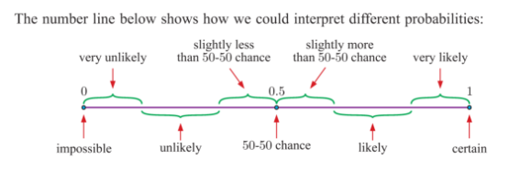
24
7
30
Probability
Date
EQ – What words can you use to describe situations involving chance?

Slide 7
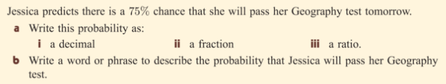

24
7
30
Probability
Date
EQ – What words can you use to describe situations involving chance?

Slide 8
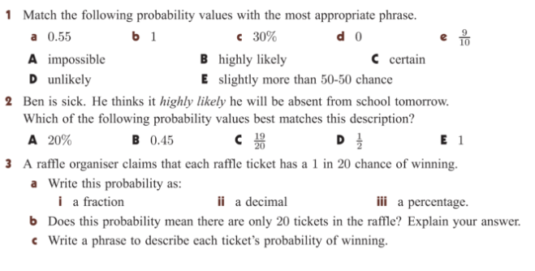
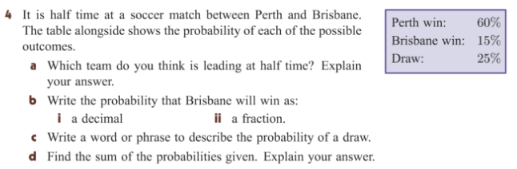
Practice Time:

Slide 9
Practice Time:

